Slide 1
Summer Training Internship
By Lakshyajeet Singh Goyal
21EJICS070
Notes:
My name is LSG and I am currently pursuing an internship in the field of machine learning and data science. During this presentation, I’ll be sharing with you some of the key learnings and experiences from my internship so far.

Slide 2
Summer Training
Training at
Zeetron Networks,
Tonk Road,
Jaipur
Field - Machine Learning with Data Science

Slide 3
Lesson Plan
Week 1
Revision of Python Concepts
Introduction to NumPy module
Introduction to Datetime and Colorama Module
Advance Python concepts
Map Filter and Reduce Function
Week 2
Arrays Functions in NumPy
Operations performed on Arrays
Linear Algebra
Statistical Analysis
Introduction to CSV files
Week 3
Introduction to Pandas
DataFrame creation and manipulation
Introduction to Series
Introduction to Web Scraping
Converting scraped data to DataFrames
Notes:
Here’s a brief overview of what we’ll be covering today. In Week 1, we focused on revision of Python concepts and introduction to various modules. In Week 2, we worked on arrays functions in NumPy and operations on arrays. And in Week 3, we worked on Pandas and web scraping.

Slide 4
Week 1
Basics of Python
Reshape and Map Function
Lambda Function
Introduction to Numpy
Numpy 2D Array
Conversion of Python Data type into Numpy Arrays
Colorama Module
Notes:
In Week 1, our main focus was on revising fundamental Python concepts and getting introduced to various modules such as NumPy, Datetime and Colorama. We also covered advanced Python concepts such as map, filter, and reduce functions.

Slide 5
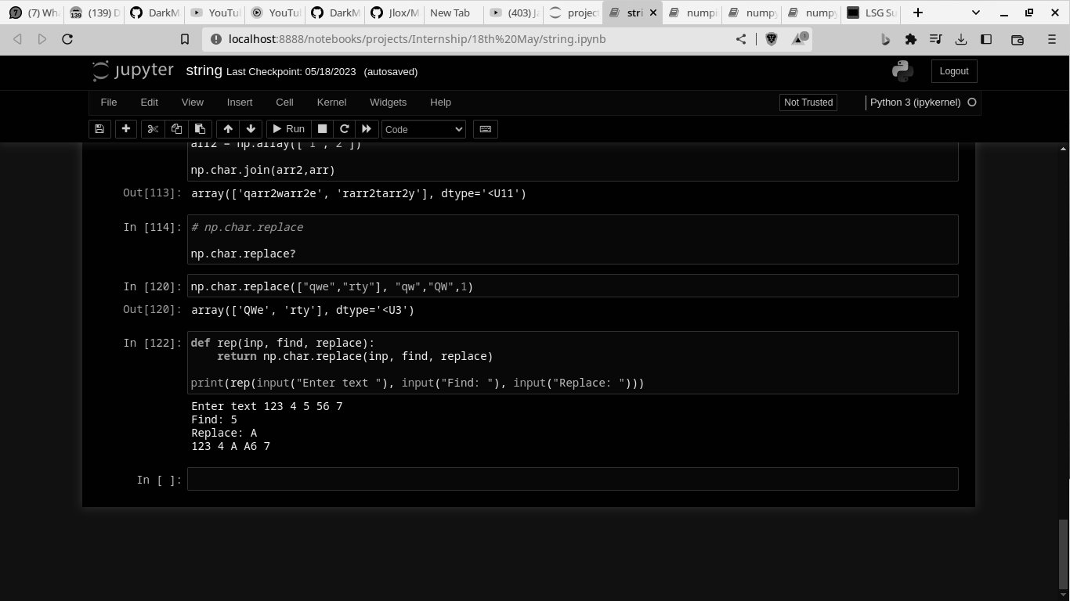
Week 1 - Revision of Python Concepts
Basics of Python
Defining and Calling functions
Lambda function
Control flow
Notes:
During this week, we revised some of the fundamental concepts in Python such as data types, control structures, functions and modules. This provided a solid foundation for the rest of the internship.

Slide 6
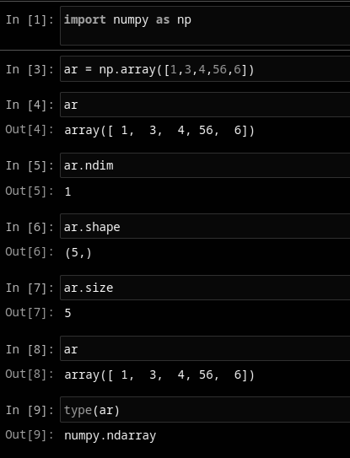
Week 1 - Introduction to NumPy Module
Introduction to Modules in Python
Array Data Structure
Creating an Array from List
Operations on Array
Dimensions and Reshaping
Notes:
We also got introduced to the NumPy module which is a powerful library for numerical computing in Python. We learned about its capabilities for working with arrays and performing mathematical operations on them.

Slide 7
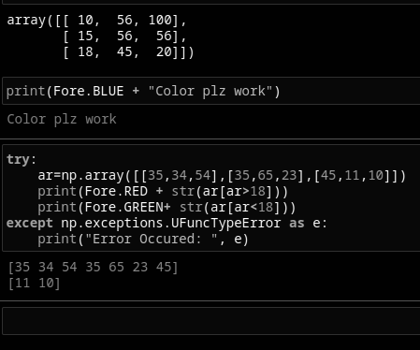
Week 1 - Datetime and Colorama Module
Introduction to Datetime
Getting current Date and Time
Printing Colored information with colorama
Arithmetic Operations on Date Object
Notes:
We also got introduced to the Datetime and Colorama modules. The Datetime module provides classes for manipulating dates and times while the Colorama module makes it easy to color terminal text.

Slide 8
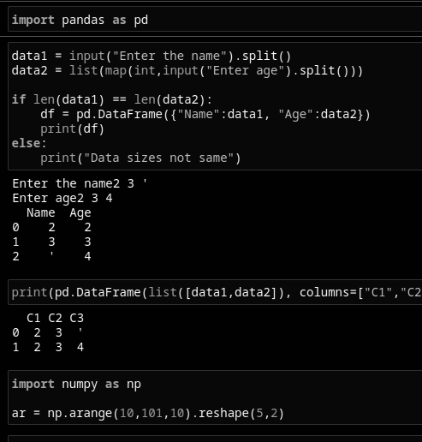
Week 1 - Advance Python Concepts
Classes and OOP
Special Functions in Class
Map, Filter and Reduce functions
Exception Handling
Notes:
We also covered advanced Python concepts such as map, filter, and reduce functions. These functions allow us to apply a function to a sequence of elements in a concise and efficient manner.

Slide 9
Week 2
NumPy 3D Array
NumPy Arange Function
Slicing Arrays
Base conversion of Data in Arrays
Introduction to Pandas
Notes:
n Week 2, our focus shifted to working with arrays using NumPy. This included topics such as array functions, operations on arrays, linear algebra, statistical analysis and introduction to CSV files.

Slide 10
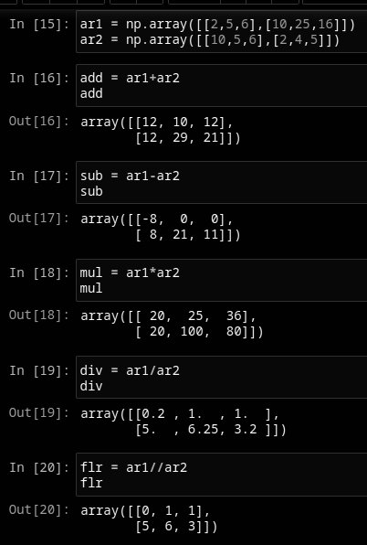
Week 2 - Arrays Functions in NumPy
Arange Function
Random Function
Dimensionality of an Array
Shape of Array
Map function of Array
Notes:
During this week, we learned about various array functions available in NumPy such as arange, linspace, logspace and meshgrid. These functions allow us to create arrays with specific properties in a concise manner.

Slide 11
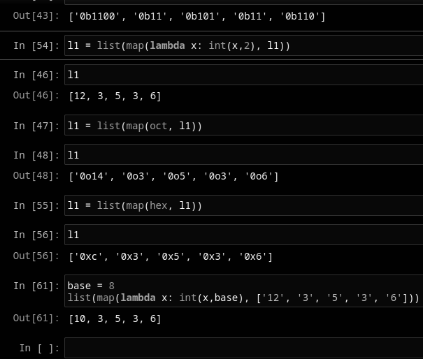
Week 2 - Operations Performed on Arrays
Indexing and Slicing
Arithmetic Operations on Array
Filter and Map on Array
Reshape function
Changing Dimension of Arrays
Notes:
We also learned about different operations that can be performed on arrays using NumPy such as indexing, slicing, reshaping and concatenation. These operations allow us to manipulate arrays in powerful ways.

Slide 12
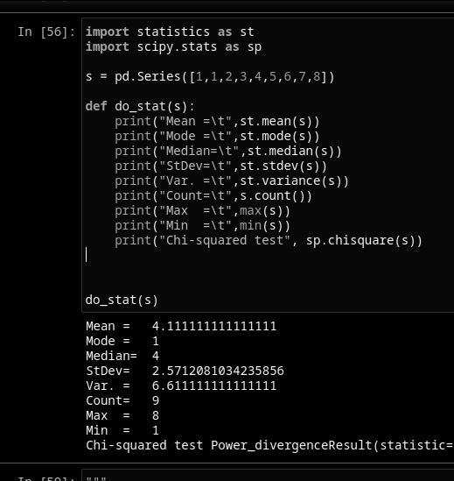
Week 2 - Linear Algebra
Introduction to Statistics library
Statistics Theory
Introduction to SciPy Library
Advanced Statistic functions with SciPy
Notes:
inear algebra is a fundamental tool in machine learning and data science. During this week, we learned how to use NumPy to perform linear algebra operations such as matrix multiplication, inversion and eigendecomposition.
We also learned how to use NumPy for statistical analysis. This included topics such as mean, median, mode, standard deviation and correlation.

Slide 13
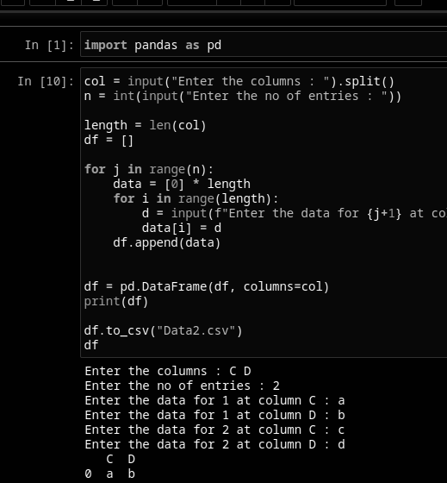
Week 2 - Introduction to CSV Files
CSV File Structure
Manually creating CSV File
Saving an Array to CSV File
Loading data from CSV
Notes:
We also got introduced to reading and writing CSV files using NumPy. This is an important skill as CSV files are commonly used for storing and exchanging data.

Slide 14
Week 3
Introduction to Pandas
Creating and Manipulating DataFrames
Websraping data to DataFrames
Saving and Loading DataFrames to CSV
Connecting Python to MySQL
Notes:
In Week 3, our focus shifted to working with Pandas. This included topics such as data frame creation and manipulation, introduction to series and web scraping.

Slide 15
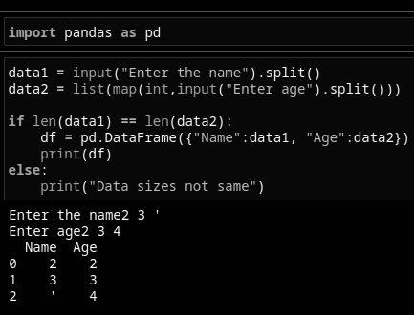
Week 3 - Introduction to Pandas
Introduction to the Pandas module
Creating a DataFrame from Python Collections
Converting NumPy Arrays to DataFrame
Notes:
Pandas is a powerful library for data manipulation and analysis in Python. During this week, we got introduced to its capabilities for working with data frames which are two-dimensional tabular data structures with labeled axes.

Slide 16
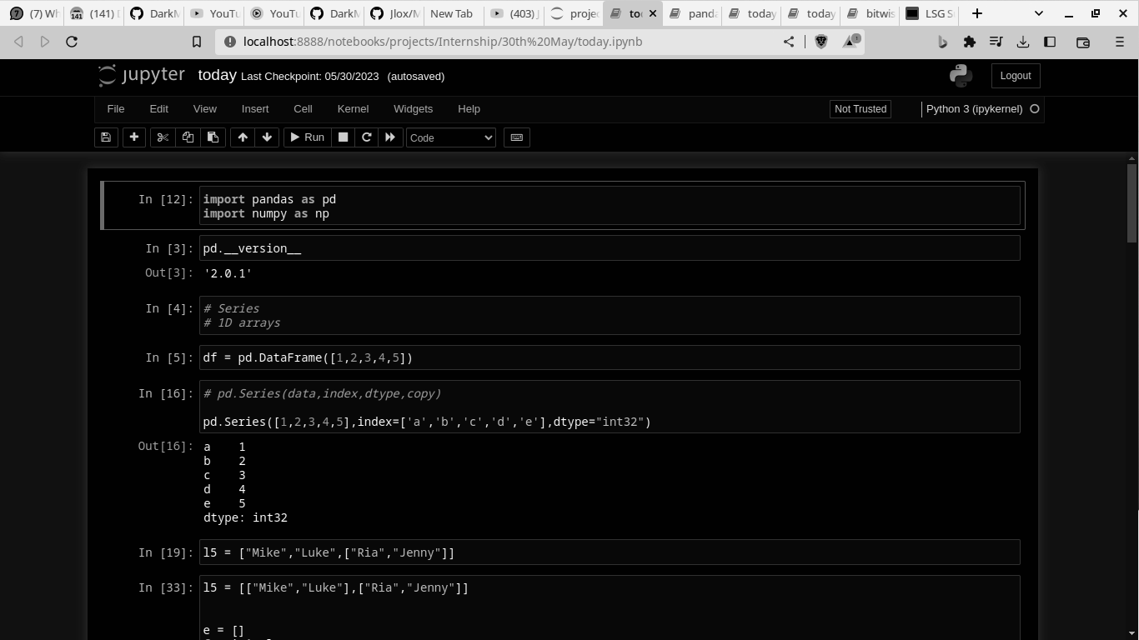
Week 3 - DataFrame Creation and Manipulation
Creating DataFrame from CSV files
Adding and Dropping Columns
Pandas Map function
Plotting DataFrame
Introduction to Matplotlib
Notes:
We learned how to create data frames from various sources such as dictionaries, lists and CSV files. We also learned how to manipulate data frames using operations such as indexing, slicing, filtering and aggregation.

Slide 17
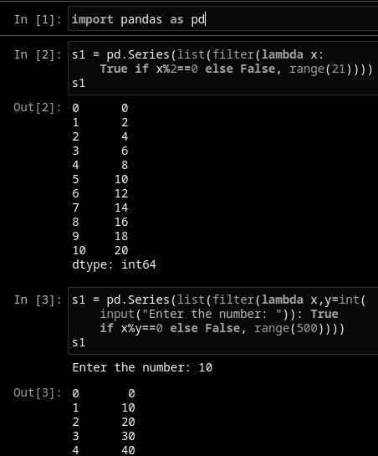
Week 3 - Introduction to Series
Creating Pandas Series from Python Collections
Series Operations
Joining Series to make DataFrame
Map function on Series
Notes:
We also got introduced to series which are one-dimensional labeled arrays in Pandas. We learned how to create series from various sources such as lists and dictionaries and how to manipulate them using operations such as indexing, slicing and filtering.

Slide 18
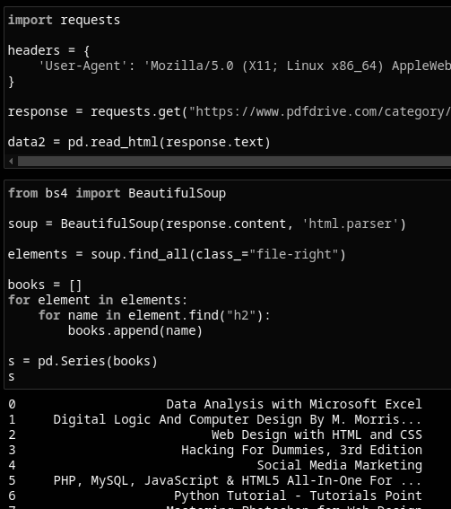
Week 3 - Introduction to Web Scraping
Web scraping with Pandas
Requests module introduction
Converting web data to DataFrames
Visualizing DataFrames
Introduction to Beautiful Soup
Notes:
We also got introduced to web scraping which is the process of extracting data from websites using automated tools. We learned how to use Pandas to convert scraped data into data frames for further analysis.

Slide 19
Conclusion
In conclusion, my internship so far has been a valuable learning experience where I got the opportunity to work on real-world projects and apply my knowledge of data science. During these 3 weeks, I revised fundamental Python concepts and got introduced to various modules such as NumPy, Datetime and Colorama. I also learned about advanced Python concepts such as map, filter, and reduce functions. In Week 2, I worked with arrays using NumPy and learned about various array functions, operations on arrays, linear algebra and statistical analysis. In Week 3, I got introduced to Pandas and learned about data frame creation and manipulation, series and web scraping. Overall, this internship has helped me to deepen my understanding of data science and has prepared me for future challenges in these fields.
Thank you.
Notes:
In conclusion, my internship was a valuable learning experience where I got the opportunity to work on real-world projects and apply my knowledge of machine learning and data science. I hope you found this presentation informative and thank you for your attention.

Slide 20
By Lakshyajeet Singh Goyal
CSE II Year IV Sem
21EJICS070

